Slide 1

Chapter 27
Drag-and-Drop Processing

Slide 2
Learning Objectives
How a drag-and-drop operation works
How to create a draggable element within a webpage
How to respond when a drag operation starts
How to specify that an area allows an object to be dragged into it and dropped
How to perform the drop operation

Slide 3

Getting Started With Drag-and-Drop Content
Many of the webpages you use on a regular basis may already support some forms of drag-and-drop operations.
These moused-based operation allow you to click on an object and then move the object, while holding down the mouse button, to a new location.
When you release the mouse button, the software drops the object at the new location.
If you drag the Google graphic using your mouse, you will find that the graphic can be moved around the page. In addition, you may even be able to drop the graphic onto your desktop.

Slide 4
Creating a Draggable Webpage Element
Under HTML 5, you make virtually any element draggable by assigning the draggable=“true” attribute to the element.
<imgsrc="dog.jpg" draggable="false" id="dog" width="400" height="300" /> <imgsrc="cat.jpg" draggable="true" id="cat" width="400" height="300"/>

Slide 5
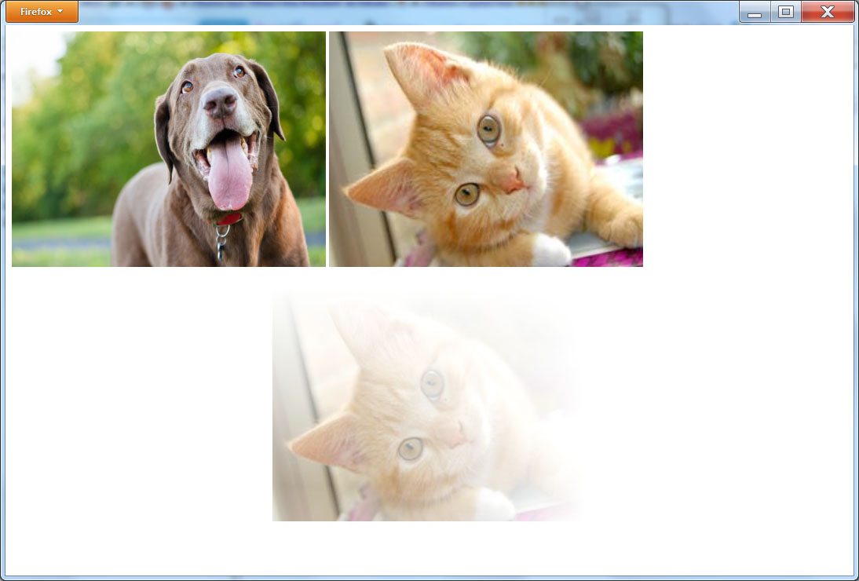
Drag and drop example
<!DOCTYPE html> <html> <body> <imgsrc="dog.jpg" draggable="false" id="dog" width="400" height="300" /> <imgsrc="cat.jpg" draggable="true" id="cat" width="400" height="300"/> </body> </html>

Slide 6
Handling a Drag Operation
After you make an HTML element draggable, the browser needs to be told what it should do with the dragged data. In this case, simply store the id of the corresponding image element. Later, use the id to move the data to a target location.
The following HTML file, SpecifyDragElementId.html, shows Step 2 of the drag-and-drop process—Step 1 was making the element draggable. As you will see, the file responds to the ondragstart event by assigning the id of the cat image to the drag event:

Slide 7
Handling a drag operation
<!DOCTYPE html> <html> <head> <script> function drag(event) { event.dataTransfer.setData("Text", event.target.id); } </script> </head> <body> <imgsrc="dog.jpg" draggable="false" id="dog" width="400" height="300" /> <imgsrc="cat.jpg" draggable="true" id="cat" width="400" height="300" ondragstart="drag(event)"/> </body> </html>

Slide 8
Making an Area “Dropable”
By default, the areas within a webpage will not allow content to be dragged into the area or dropped. To specify that an area should allow content to be dragged into it, turn off the element’s default behavior.
The following HTML file, ProvideTarget.html, creates a division within the page that is capable of storing dragged data:

Slide 9
Defining a drop area
<!DOCTYPE html> <html> <head> <script> function permitdrop(event) { event.preventDefault(); } function drag(event) { event.dataTransfer.setData("Text", event.target.id); } </script> </head> <body> <imgsrc="dog.jpg" draggable="false" id="dog" width="400" height="300" /> <imgsrc="cat.jpg" draggable="true" id="cat" width="400" height="300" ondragstart="drag(event)"/> <br/> <div ondragover="permitdrop(event)" style="background-color: yellow; width:400px; height:300px"></div> </body> </html>

Slide 10
Allowing the Drop Operation to Occur
Just as an area within a webpage normally does not allow objects to be dragged into the area, the area also does not allow an object to be dropped.
The last step to providing drag-and-drop support is specifying the processing that should occur when you drop an object.
The following HTML file, CatDragAndDrop.html, allows you to drag and drop the cat image from the top of the page to the area at the bottom of the page:

Slide 11
Handling the drop
<!DOCTYPE html> <html> <head> <script> function drop(event) { event.preventDefault(); var data=event.dataTransfer.getData("Text"); event.target.appendChild(document.getElementById(data)); } function permitdrop(event) { event.preventDefault(); } function drag(event) { event.dataTransfer.setData("Text", event.target.id); } </script> </head> <body> <imgsrc="dog.jpg" draggable="false" id="dog" width="400" height="300" /> <imgsrc="cat.jpg" draggable="true" id="cat" width="400" height="300" ondragstart="drag(event)"/> <br/> <div ondragover="permitdrop(event)" ondrop="drop(event)" style="background-color: yellow; width:400px; height:300px"></div> </body> </html>

Slide 12
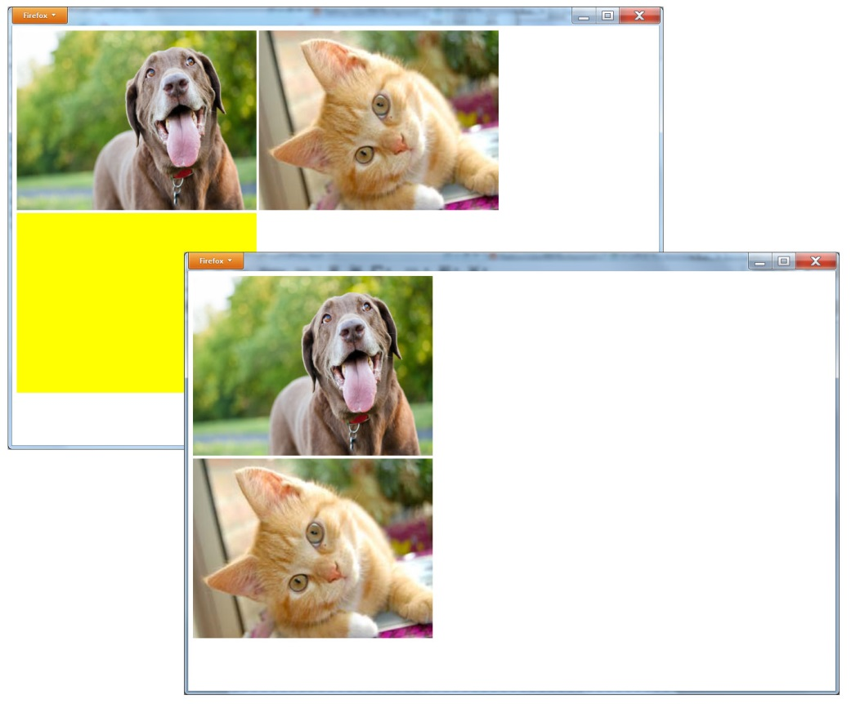
Dragging and dropping the cat

Slide 13
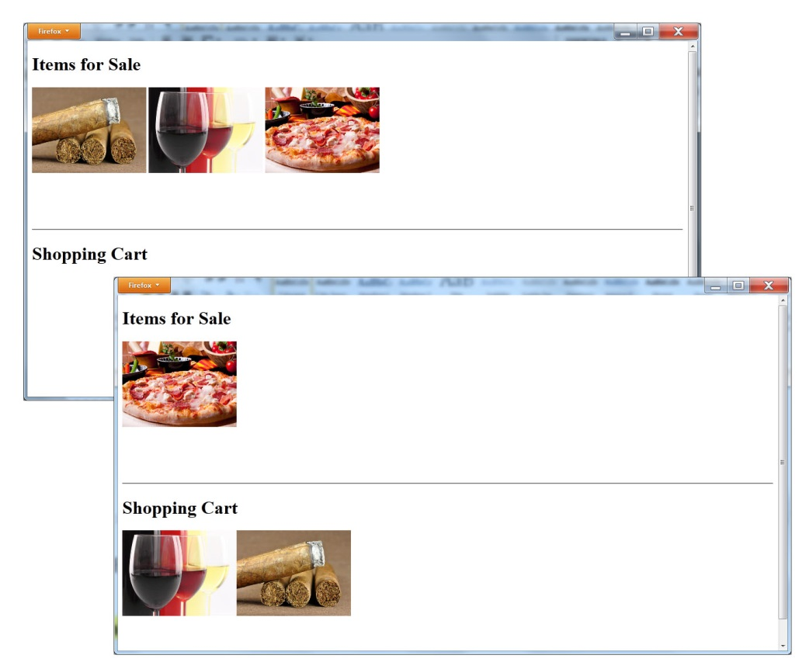
Second example – shopping cart

Slide 14
Note the steps
<!DOCTYPE html> <html> <head> <script> function drop(event) { event.preventDefault(); var data = event.dataTransfer.getData("Text"); event.target.appendChild(document.getElementById(data)); } function permitdrop(event) { event.preventDefault(); } function drag(event) { event.dataTransfer.setData("Text", event.target.id); }

Slide 15
continued
</script> </head> <body> <div style="height:300px; width:800px;" ondragover="permitdrop(event)" ondrop="drop(event)" > <h1>Items for Sale</h1> <imgsrc="cigars.jpg" draggable="true" id="cigars" width="200" height="150" ondragstart="drag(event)"/> <imgsrc="wine.jpg" draggable="true" id="wine" width="200" height="150" ondragstart="drag(event)"/> <imgsrc="pizza.jpg" draggable="true" id="pizza" width="200" height="150" ondragstart="drag(event)"/></div> <hr/> <div style="height:300px; width:800px;" ondragover="permitdrop(event)" ondrop="drop(event)"><h1>Shopping Cart</h1></div> </body> </html>

Slide 16
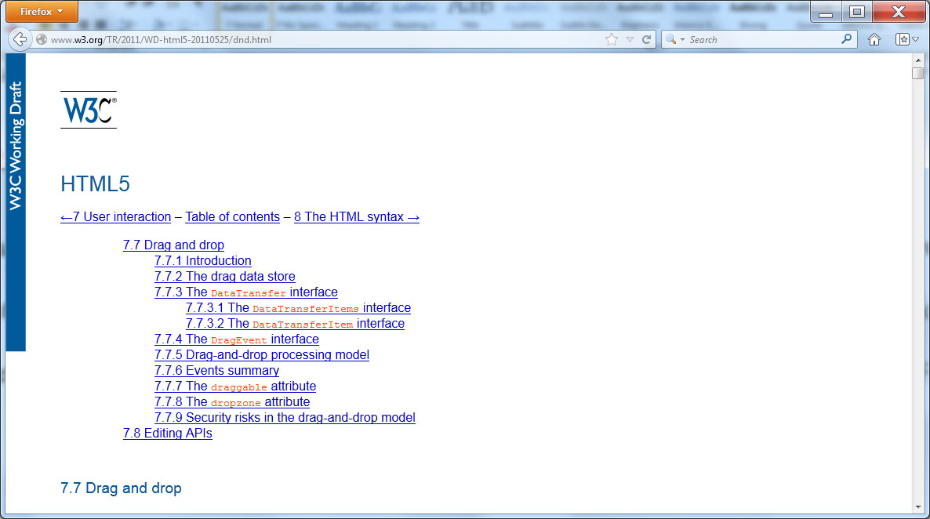
Real world design – drag and drop specification

Slide 17
summary
Drag-and-drop operations are common within most application programs today. HTML 5 provides drag-and-drop support for webpage elements.
Using HTML 5 drag and drop, you might, for example, be able to drag items from a catalog into a shopping cart. In the near future, the ability will exist to drag items from a page into other applications or vice versa.
This chapter introduced drag-and-drop operations.

